Slide 1


Mining Mercyhurst: Predicting Future University Tweet Engagement
CIS 572 Social Media Text Mining
Justin Minsk
Kyndra Zacherl
Nemanja Matijevic
Cassandra Egelston

Slide 2

MINING MERCYHURST
Utilized Twitter API (tweepy) to scrape 3200 tweets from @mercyhurstu
Saved each tweet as an individual dictionary (containing tweet id, body, date, favorites, and retweets) to a list
Created a pandas DataFrame from the list of tweets
Exported DataFrame to a Parquet file for more efficient storage and easier implementation into the model
pd_list = []
with open('mm.json') as file:
tweets = json.load(file)
for x in tweets:
tweet_id = x['id']
text = x['text']
date = x['created_at']
favs = x['favorite_count']
rts = x['retweet_count']
pd_list.append({'tweet_id': str(tweet_id),
'body': str(text),
'favorites': int(favs),
'retweets': int(rts),
'date_created': date})
df = pandas.DataFrame(pd_list, columns=['tweet_id', 'body',
'favorites', 'retweets', 'date_created'])
write('mm.pq', df)

Slide 3

CLEANING THE DATA
Importing the data from a Parquet file to a Pandas DataFrame
Remove URLS, @ symbol and user name, symbols, and numbers
Convert contractions to the full form (e.g. aren’t to are not)
Add columns for time_since (hours), day of week, and interaction (RTs + likes)
Use TfidfVectorizer to generate the top 10,000 word grams of sizes 1-5, excluding English stop words
Fit/Transforming the word grams to the data (appending a value of 0 if the word grams do not appear in the tweet and their tfidf score if they do)
Exporting the data as a Parquet file (date_created as index), again for efficiency

Slide 4
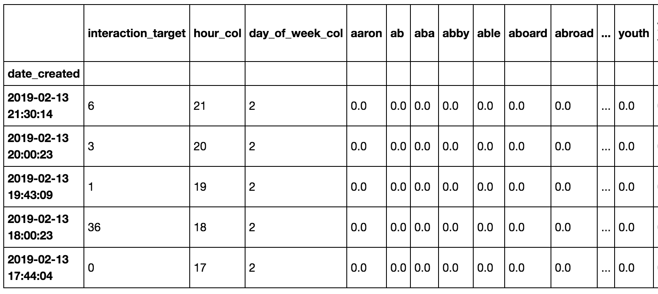
CLEANED PANDAS DATAFRAME

Slide 5
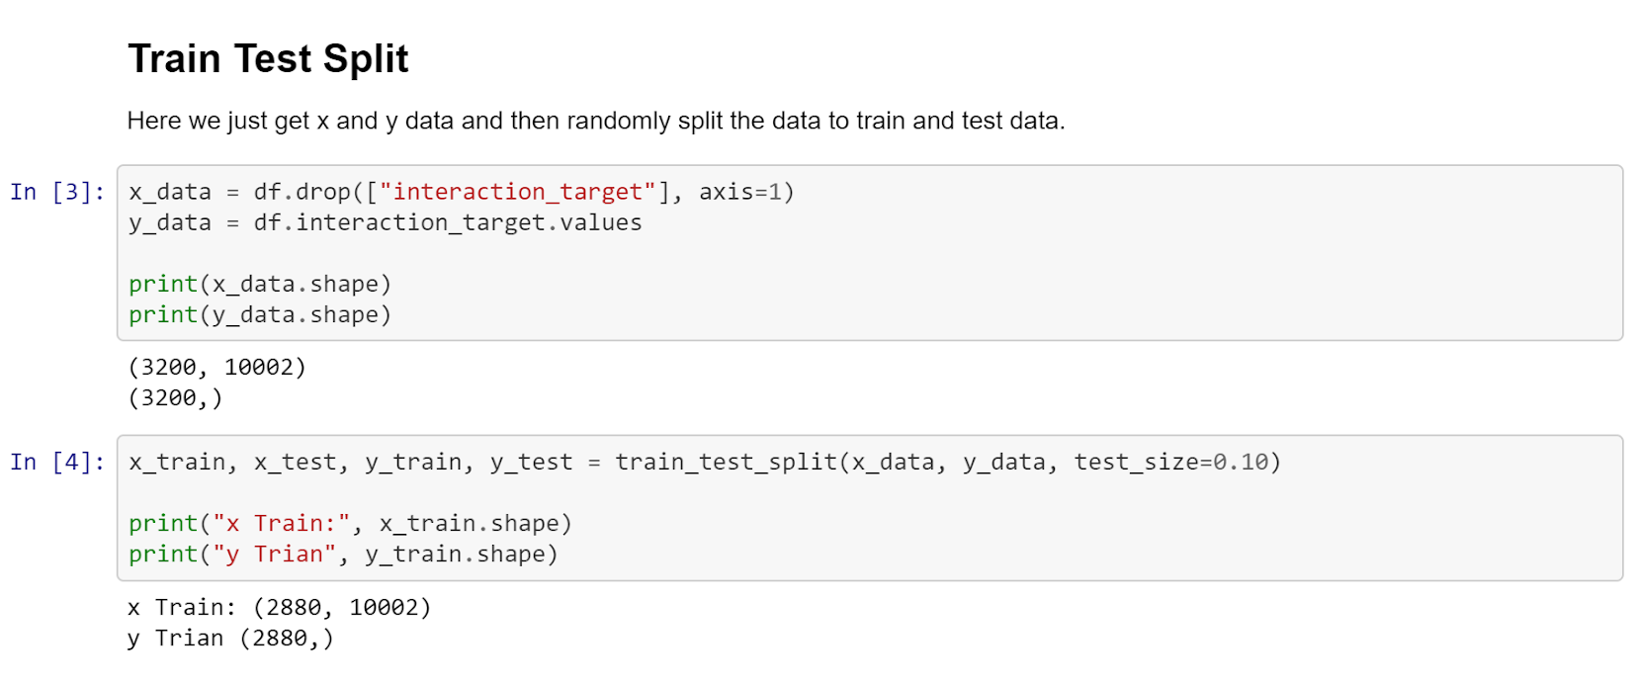
SPLITTING DATA: TRAIN/TEST
Parameter of interest: interaction
Use train_test_split() with a test size of 0.10
This splits the data 90/10 into training and testing

Slide 6
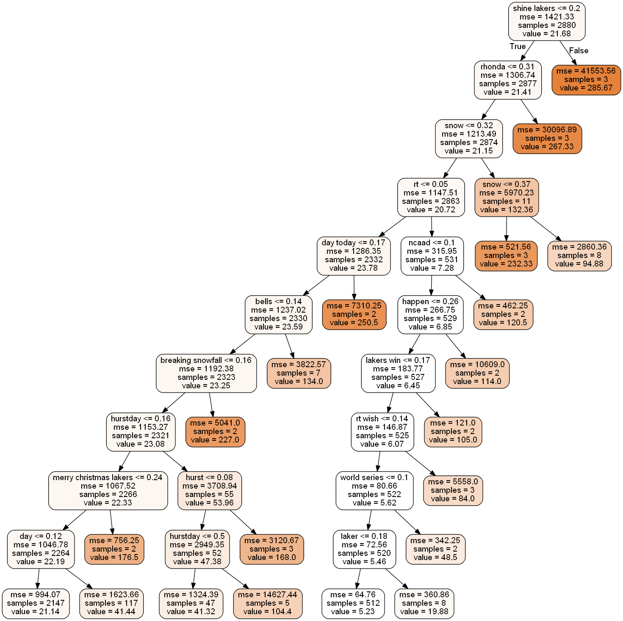
Decision Tree Model
Using cross validation 30 times to generate the best fitting model
Calculated using gini score, based on information theory
The higher the score, the more information it gives
Value refers to the amount of combined interaction a tweet received
Dark orange = it has less samples or is a more pure node

Slide 7

Decision Tree Model
Establishing which column gives the most information: all output was character grams
No information was outputted regarding hour of day or day of week (likely due to scheduled tweets)
Gave r² score of 0.050587
('shine lakers', 0.1735414221411331), ('snow', 0.14671491141406612), ('rhonda', 0.10725804493229295), ('rt', 0.09972281144760947), ('mercyhurst campus', 0.0894741213580887), ('day today', 0.08543156337916988), ('bells', 0.07104530807753547), ('breaking', 0.06899281046650114), ('day', 0.0378703298527724), ('views', 0.03221349919782629), ('happen', 0.018990984219727065), ('day classes', 0.018465712716068113), ('atlanticregional', 0.01605637901982497), ('rt wish', 0.015053885993862832), ('vallimont', 0.009746944779810343), ('state', 0.007318914388577637), ('headed', 0.00210235661513342)]

Slide 8
RANDOM FOREST MODEL
A collection of decision trees
Using RandomForestRegressor of 10 decision trees to make predictions
List features from most important to least important using gini score
Similar results to the decision tree, except ’day of week col’ was included
Produced an r² score of .11803
'snow', 0.073999882381315 'rt', 0.06491312840728636
'bells', 0.04562908813421008
'wishing', 0.03530908909778781
'rhonda', 0.02894729694673225
'rise amp shine', 0.028494234277449116
'shine lakers', 0.027964054237941727
'mercyhurst campus update', 0.02790223057784958
'mercyhurst campus update safety', 0.024719213354889347
'beautiful college', 0.02311847890528194
'rank individua', 0.023087909751449587
'time year', 0.02030927270915845
'amp shine', 0.01762698177920752
'luck today', 0.016235978873298678
'day_of_week_col', 0.014596384087108564

Slide 9
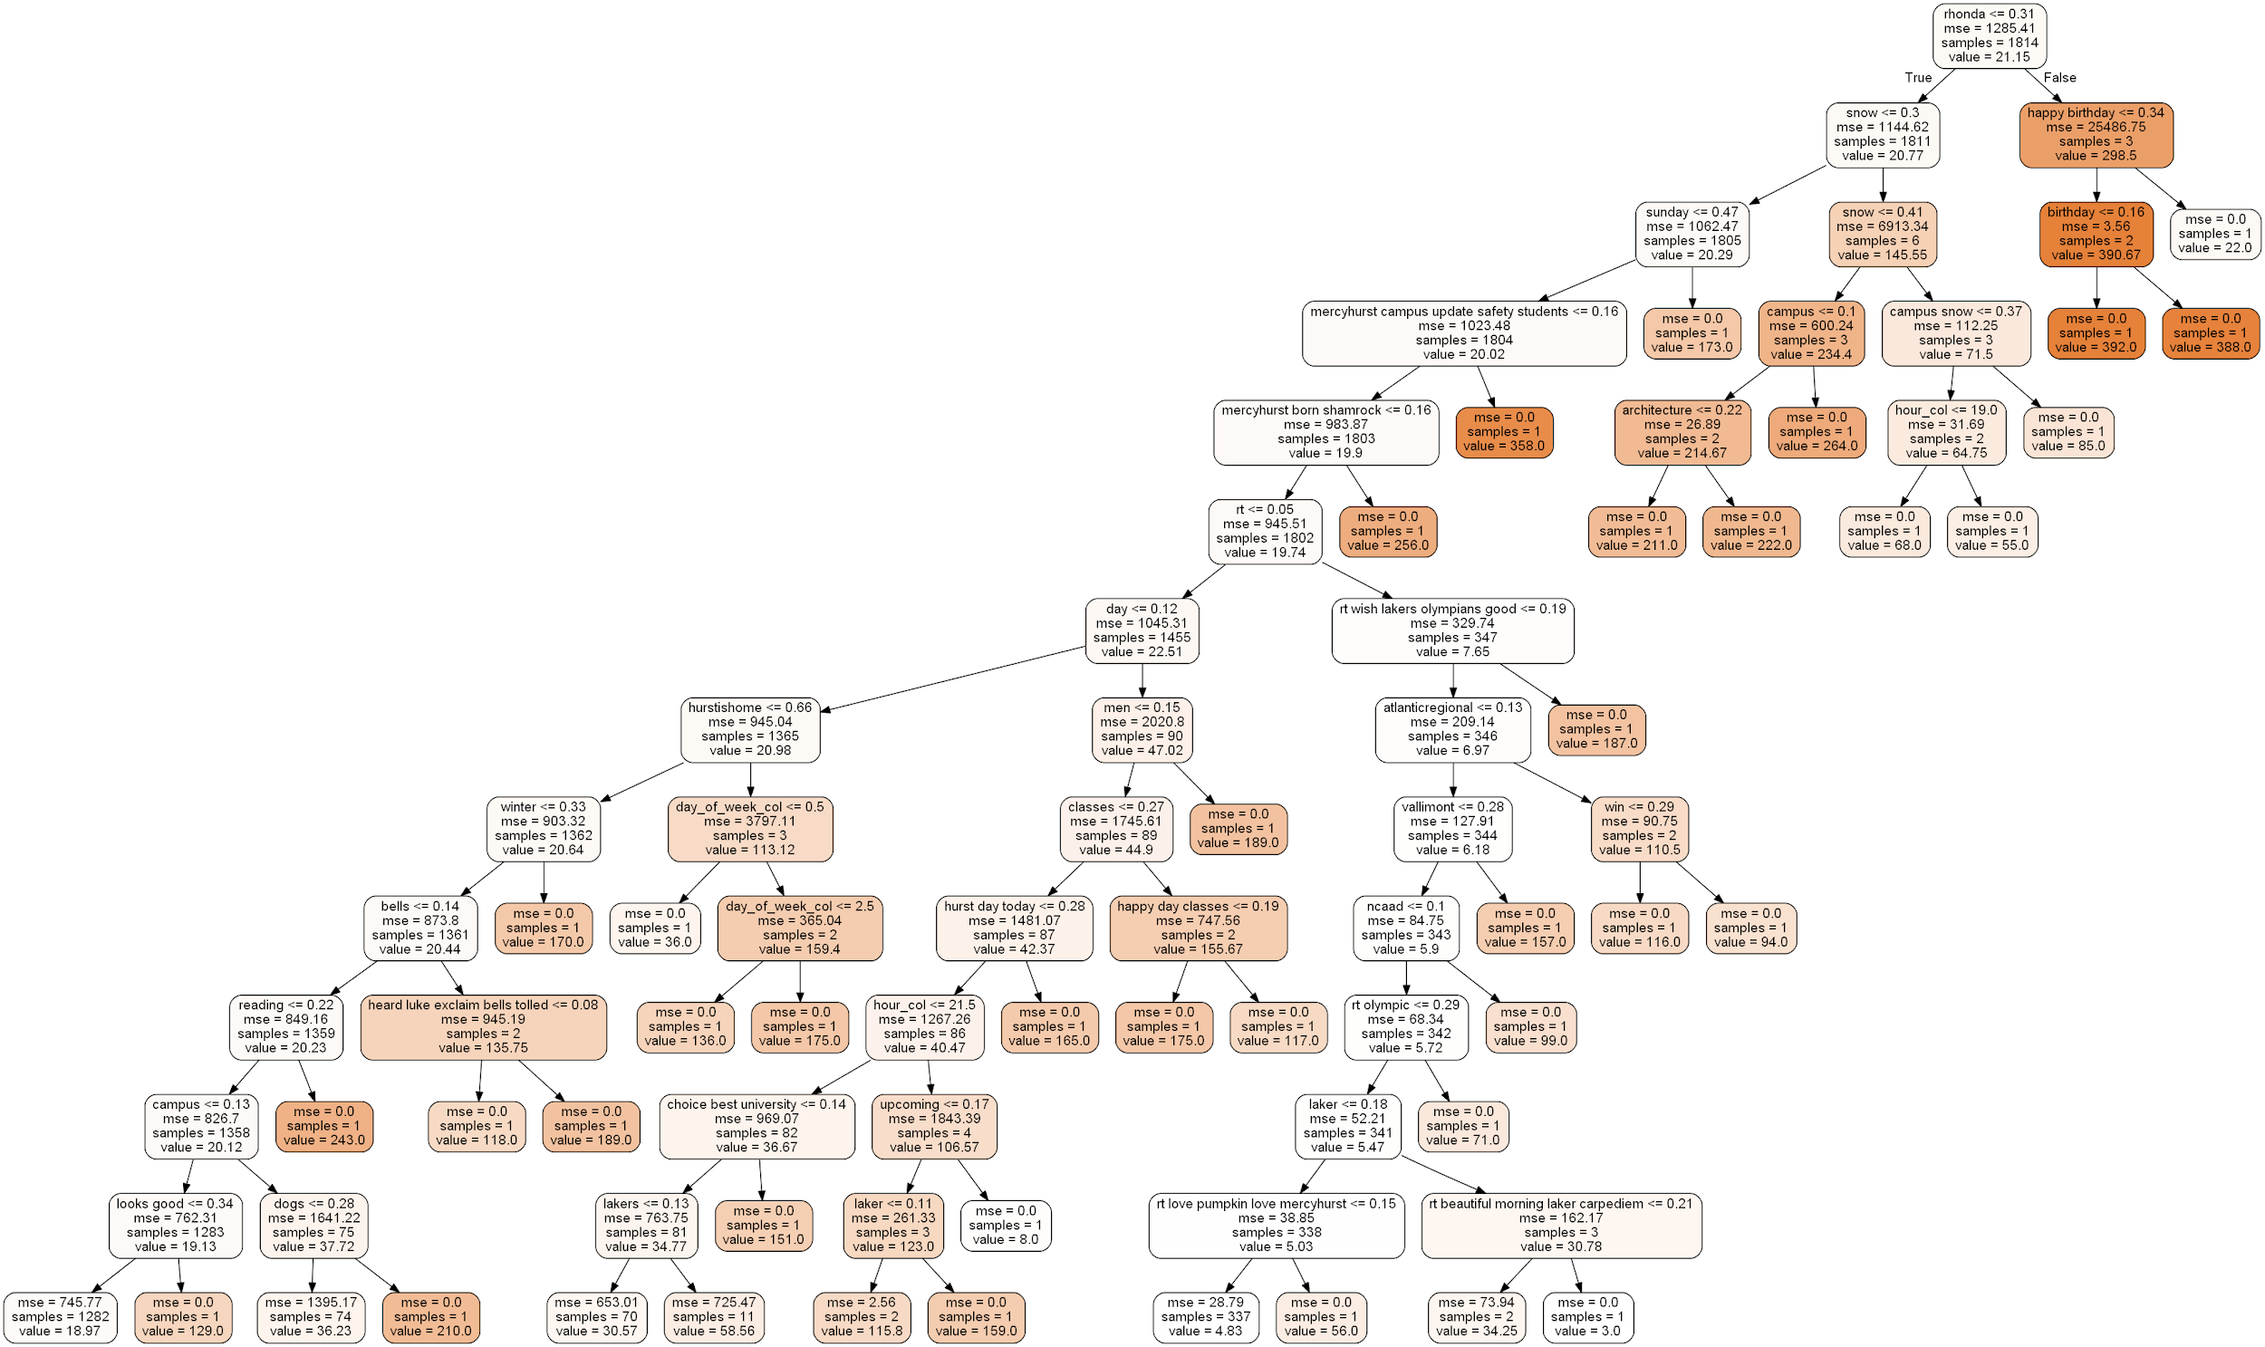

Slide 10
WORD2VEC
Use to find words that are similar
Focused on our top tweets
Shine Lakers
Rhonda
Snow
Shine Lakers | Rhonda | Snow
[('cool', 0.9995536804199219), ('past', 0.9995409250259399), ('across', 0.999535083770752), ('remember', 0.9995317459106445), ('made', 0.9995291829109192), ('weather', 0.9995264410972595), ('meet', 0.9995189905166626), ('celebration', 0.9995166659355164), ('july', 0.999510645866394), ('going', 0.9995062351226807)] | [('heres', 0.999715268611908), ('academic', 0.9997096061706543), ('share', 0.9997038245201111), ('photos', 0.9997009038925171), ('even', 0.9997005462646484), ('said', 0.9996996521949768), ('lots', 0.9996980428695679), ('dr', 0.9996959567070007), ('life', 0.9996945261955261), ('winner', 0.9996910095214844)] | [('guys', 0.9997618198394775), ('still', 0.999751627445221), ('else', 0.9997317790985107), ('following', 0.9997248649597168), ('pass', 0.9997220635414124), ('feel', 0.999721884727478), ('futurelakerfriday', 0.9997167587280273), ('chance', 0.9996986985206604), ('yesterday', 0.999690592288971), ('situation', 0.9996840357780457)]

Slide 11
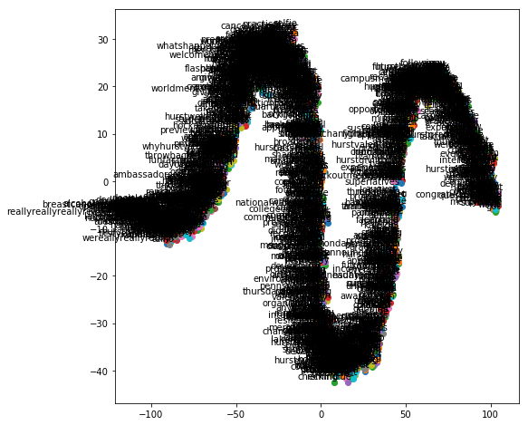

Slide 12
FUTURE IMPROVEMENTS
Collecting data from multiple Mercyhurst accounts in an attempt
Future engineering: removing words which are insignificant (e.g. day, views, happen, today)
Creating a model that would only look at retweets to determine success
Create categories that would serve as measures of success (buckets of percentiles to determine the success/failure of a tweet)
Improve upon the effectiveness of Word2Vec to better determine similar words (determine which words have the most influence beforehand)
Ability to scrape more than 3,200 tweets to discern trends over a longer period of time
Divide interaction into retweets and likes to determine if a difference exists between the two interaction types: if so, which one is more valuable to admissions and prospective students?
Create an ideal proportion of likes/retweets for the University

